Slide 1
CSS Flex, Grid, Bootstrap

Slide 2
What is Flexbox?
Flexbox, or the Flexible Box Layout Module, is a CSS3 web layout model.
Provides a more efficient way to layout, align, and distribute space among items in a container, even when their size is unknown.
2009: First introduced.
2012: Revised specification with significant changes.
2016: Fully stabilized and widely adopted after multiple iterations.
Flexbox became part of the official CSS3 specification and is now supported by all modern browsers.

Slide 3
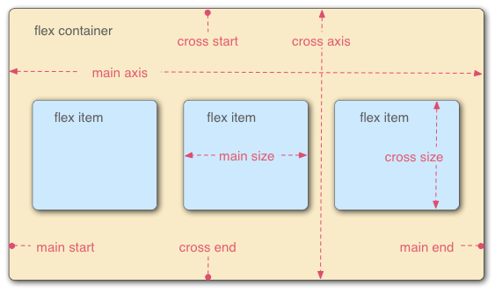
Key Concepts and Terminology
Flex Container: The parent element that contains flex items (display: flex).
Flex Items: The children of the flex container.
Main Axis: The primary axis along which flex items are laid out.
Cross Axis: The axis perpendicular to the main axis.

Slide 4
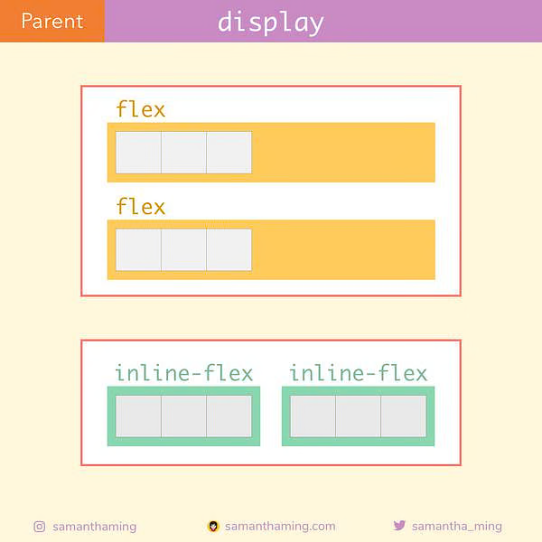
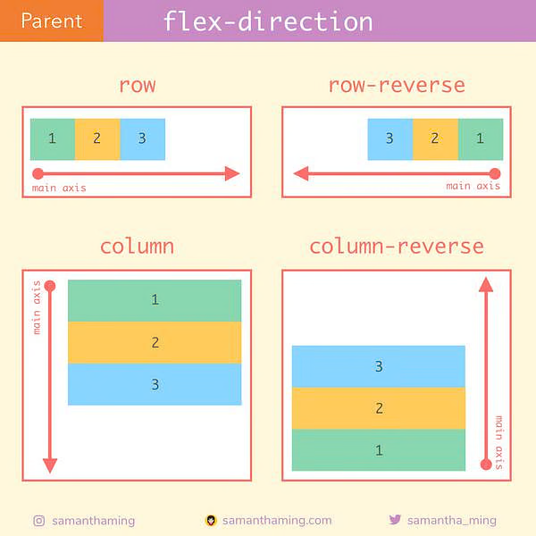
Flex Container Properties
.container {
flex-direction: row | row-reverse | column | column-reverse;
}
display: flex
display: inline-flex;

Slide 5
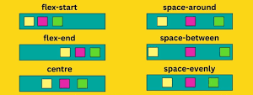
.container { justify-content: flex-start | flex- end | center | space-between | space-around | space-evenly }
justify-content:
This defines the alignment along the main axis.

Slide 6
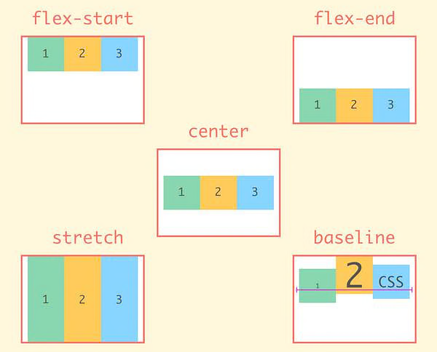
.container { align-items: stretch | flex- start | flex-end | center | baseline | first baseline | last baseline | start | end }
align-items
This defines the behavior for how flex items are laid out along the cross axis on the current line..

Slide 7
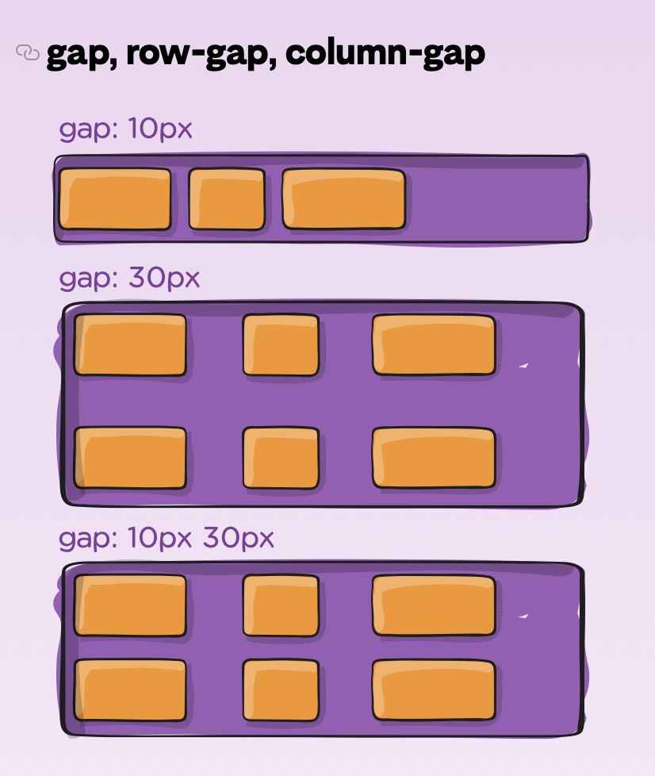
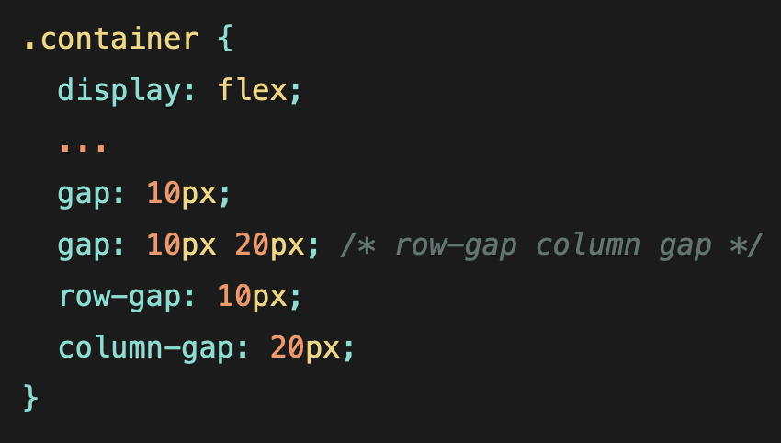
Gap
controls the space between flex items.
It applies that spacing only between items not on the outer edges.

Slide 8
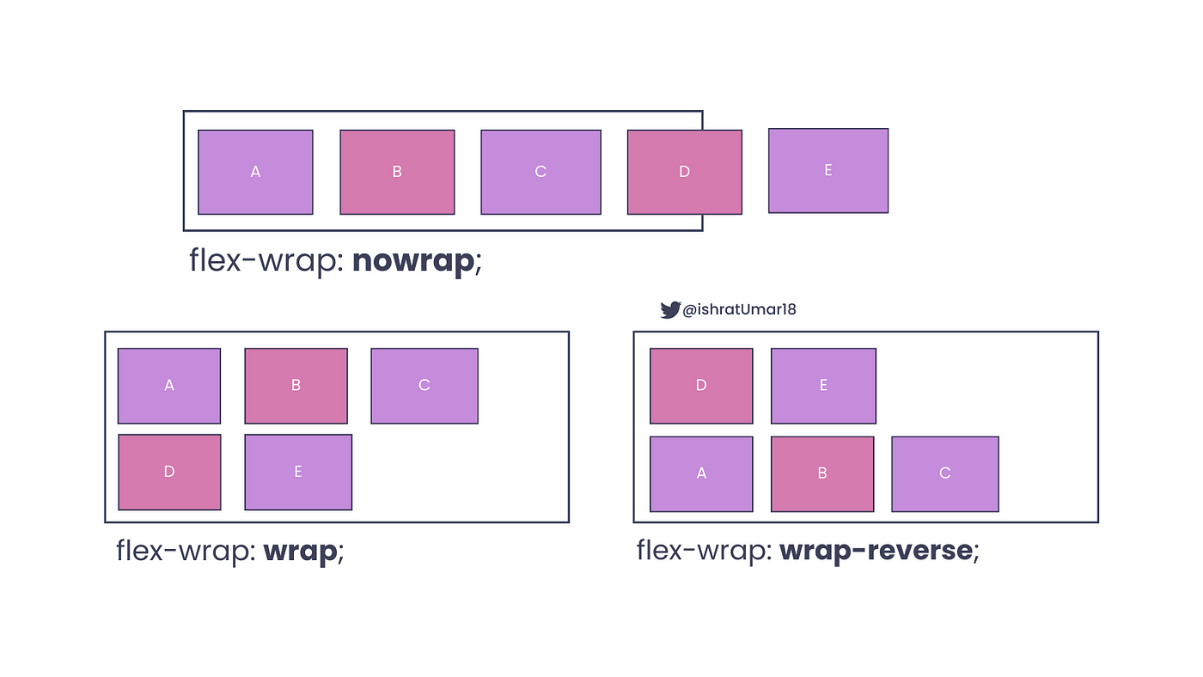
Flex-wrap
The flex-wrap property specifies whether the flexible items should wrap or not.

Slide 9
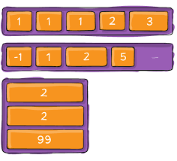
Flex-order
Sets the order to lay out an item in a flex or grid container.
Items in a container are sorted by scending order value and then by their source code order.
Items not given an explicit order value are assigned the default value of 0.

Slide 10
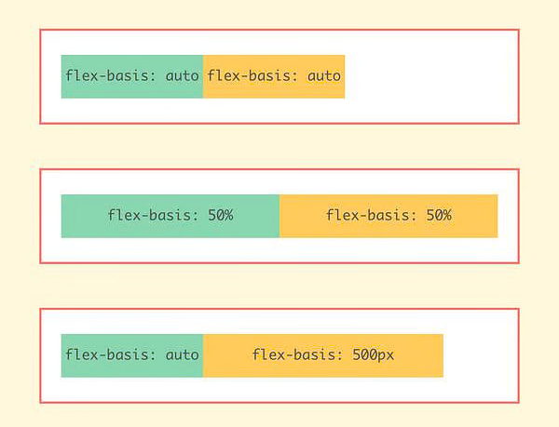
Flex-basis
specifies the initial length of a flexible item.

Slide 11
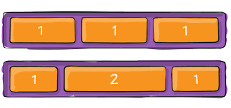
Flex-grow
sets the flex grow factor
specifies how much of the flex container's remaining space should be assigned to the flex item's main size

Slide 12
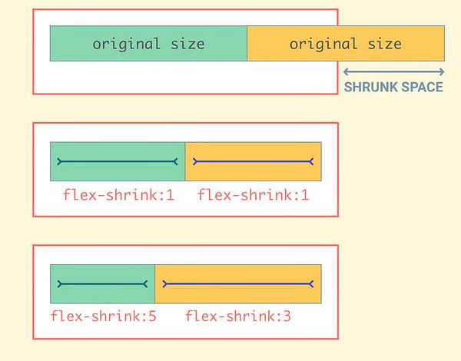
Flex-shrink
If the size of all flex items is larger than the flex container, items shrink to fit according to flex-shrink.

Slide 13
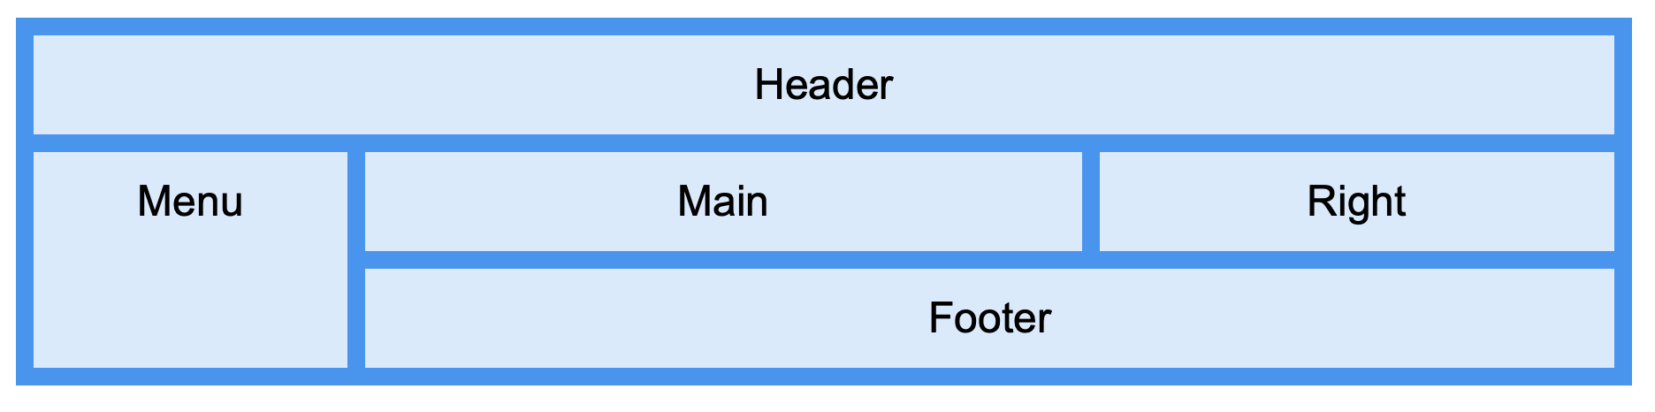
Grid
CSS Grid Layout is a two-dimensional layout system.
Used to create complex layouts using rows and columns, making it more powerful than Flexbox for certain tasks.
2011: Initial concept proposed by Microsoft.
2017: First implemented in major browsers (Chrome, Firefox, Safari).
CSS Grid is now a part of the official CSS specification and widely supported by modern browsers.

Slide 14

Advantages of Grid
Handles both columns and rows, allowing for complex layouts.
Simplifies responsive design.
Reduces the need for external libraries and frameworks.
Greater control over alignment and spacing.

Slide 15
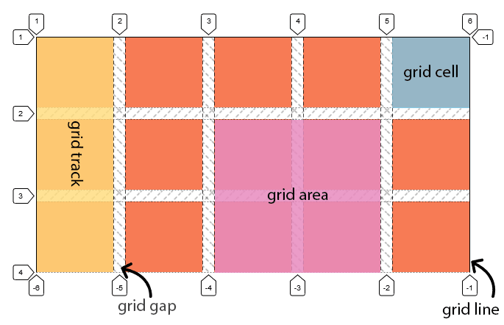
Key CSS Grid Concepts and Terminology
Grid Container: The parent element that holds grid items (display: grid).
Grid Items: The children of the grid container.
Grid Lines: The horizontal and vertical lines that divide the grid.
Grid Tracks: The space between two adjacent grid lines (rows or columns).
Grid Cells: The single unit of the grid.
Grid Areas: A rectangular area composed of one or more grid cells.

Slide 16
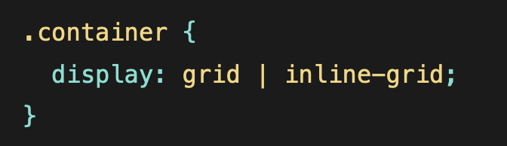
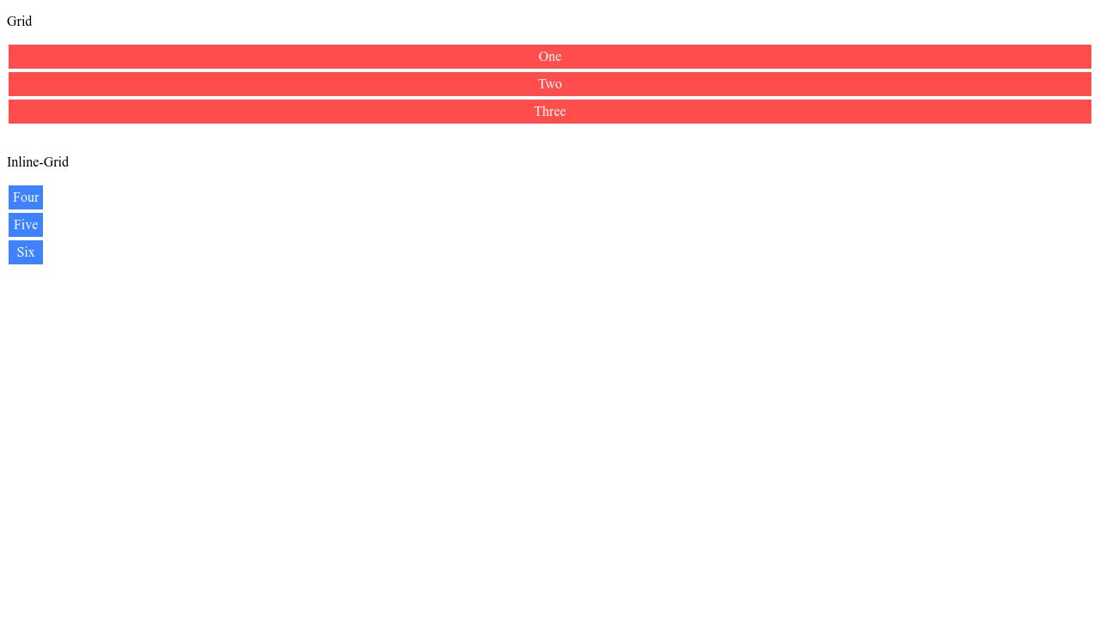
Basic Properties of Grid Container
grid – generates a block-level grid
inline-grid – generates an inline-level grid

Slide 17
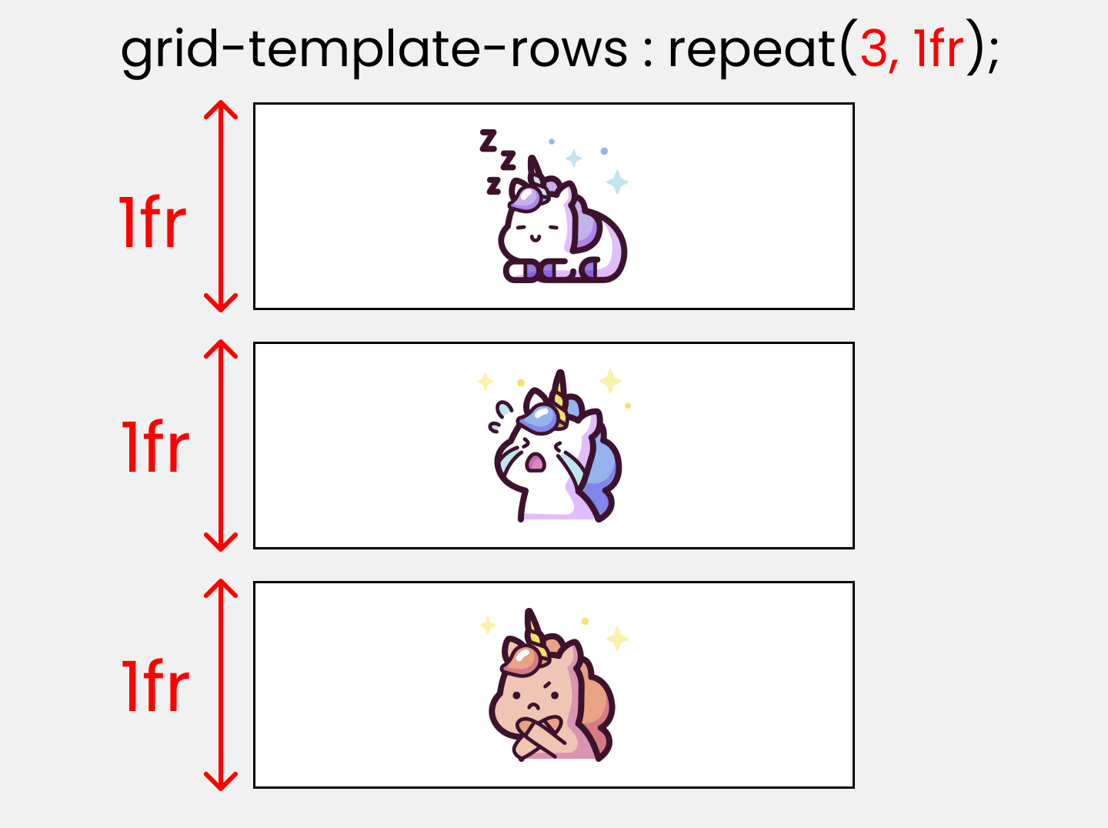
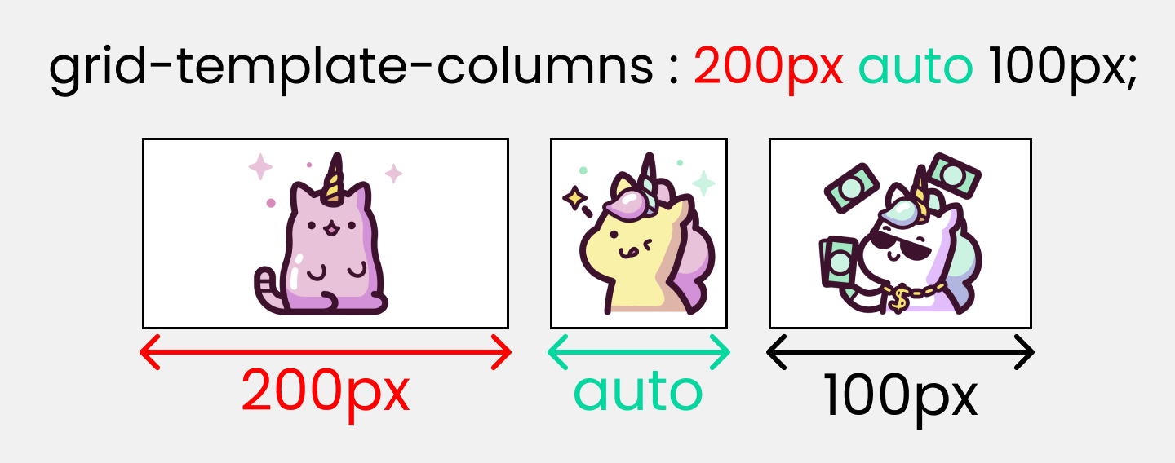
grid-template-columns /rows Defines the columns and rows of the grid with a space-separated list of values. The values represent the track size, and the space between them represents the grid line.

Slide 18
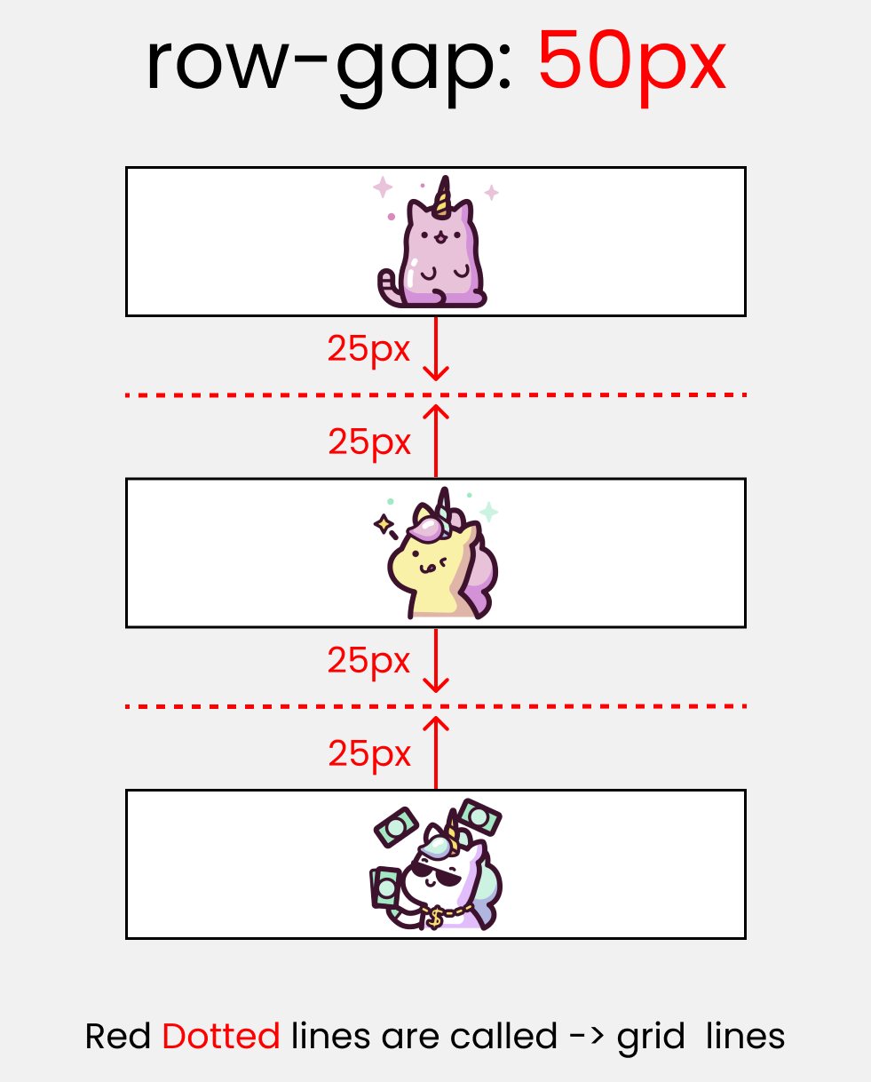
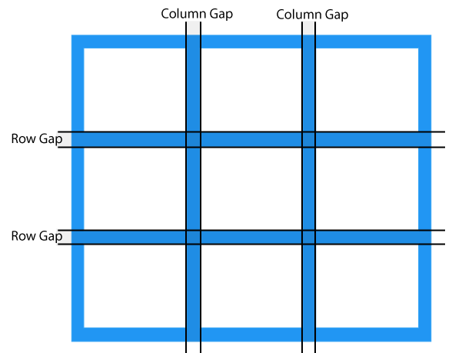
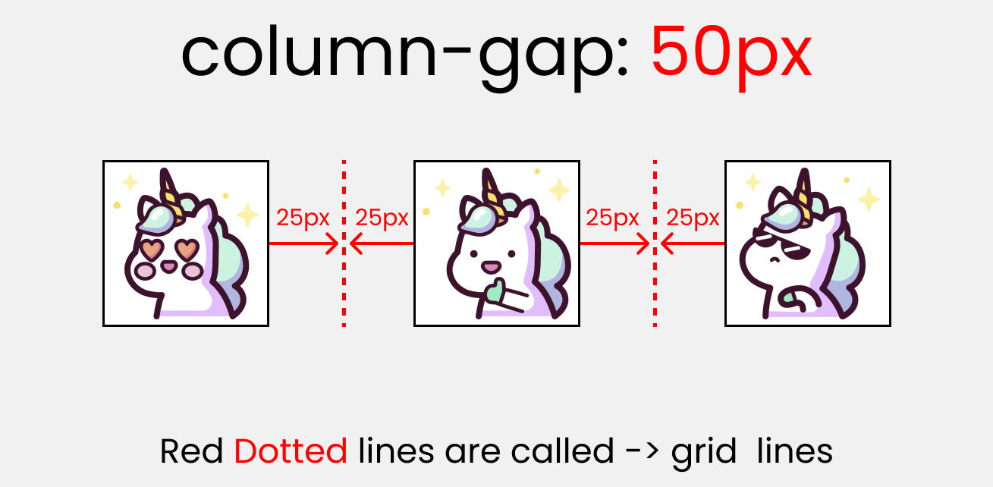
Gap: Place gap between grid items

Slide 19
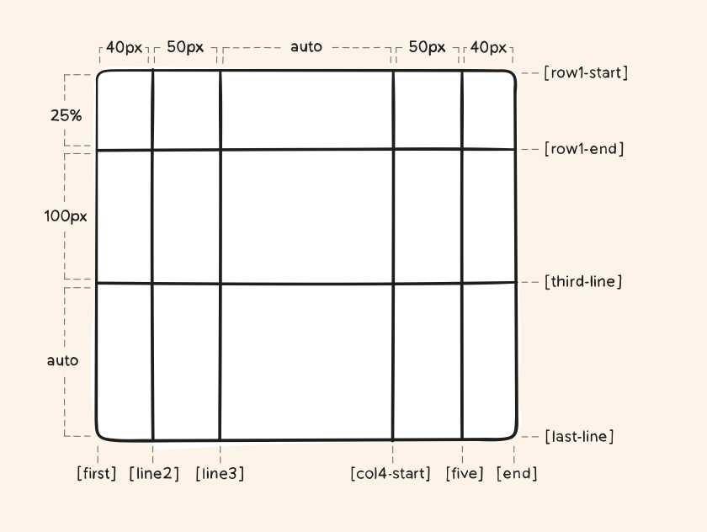
Grid sizing
.container
{ grid-template-columns:
[first] 40px
[line2] 50px
[line3] auto
[col4-start] 50px
[five] 40px
[end];
grid-template-rows:
[row1-start] 25%
[row1-end] 100px
[third-line] auto [last-line];
}

Slide 20
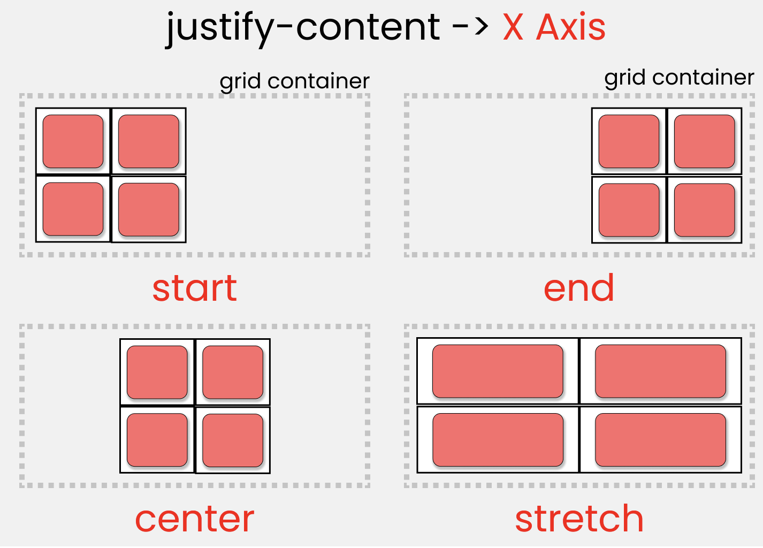
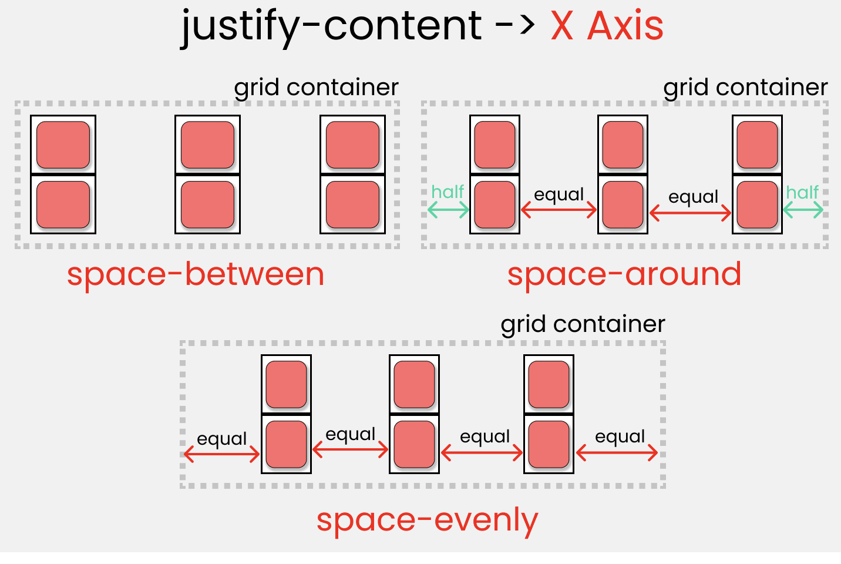
justify-content
Position grid [Basically everything] inside the grid container along the X-Axis [Main Axis]
start – aligns the grid to be flush with the start edge of the grid container
end – aligns the grid to be flush with the end edge of the grid container
center – aligns the grid in the center of the grid container
stretch – resizes the grid items to allow the grid to fill the full width of the grid container
space-around – places an even amount of space between each grid item, with half-sized spaces on the far ends
space-between – places an even amount of space between each grid item, with no space at the far ends
space-evenly – places an even amount of space between each grid item, including the far ends

Slide 21
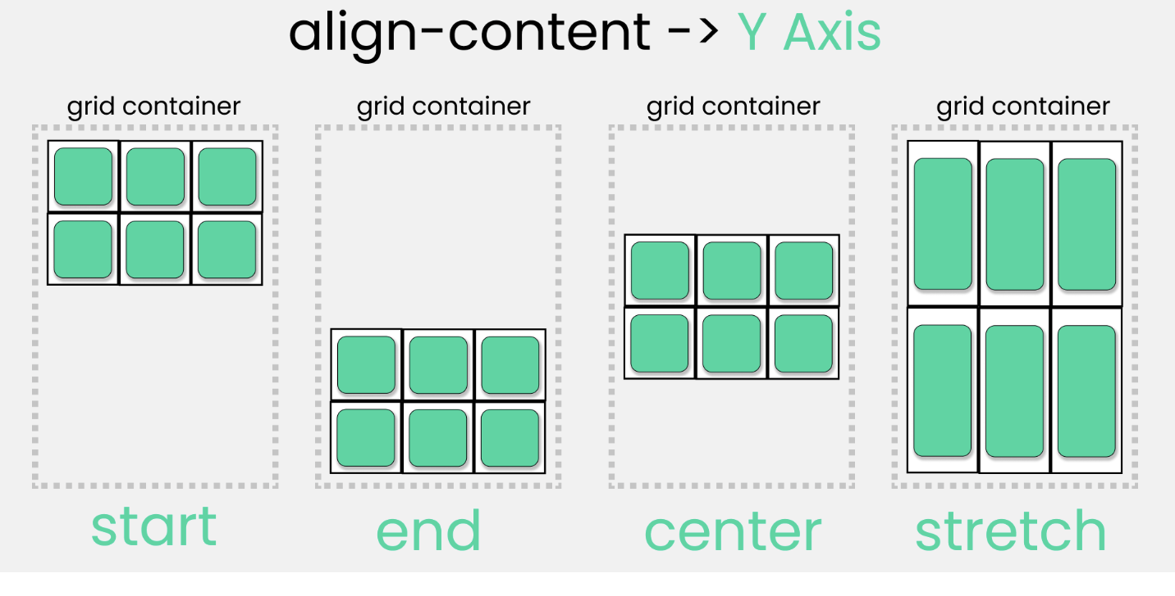
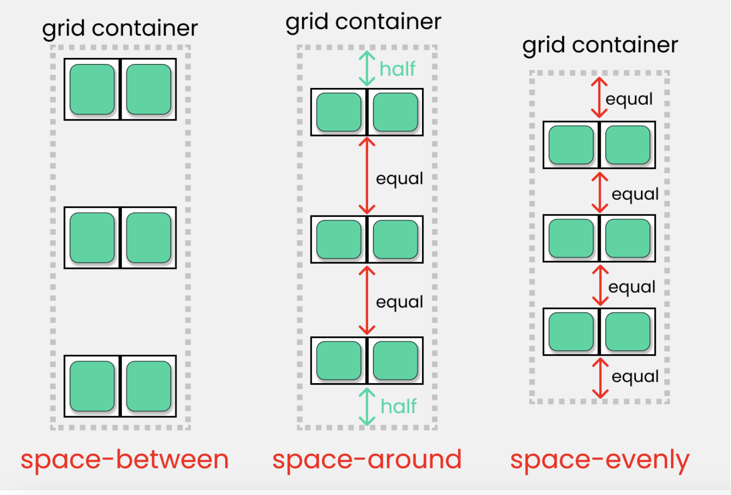
align-content
Position grid [Basically everything] inside the grid container along the Y-Axis [Cross Axis]
start – aligns the grid to be flush with the start edge of the grid container
end – aligns the grid to be flush with the end edge of the grid container
center – aligns the grid in the center of the grid container
stretch – resizes the grid items to allow the grid to fill the full height of the grid container
space-around – places an even amount of space between each grid item, with half-sized spaces on the far ends
space-between – places an even amount of space between each grid item, with no space at the far ends
space-evenly – places an even amount of space between each grid item, including the far ends

Slide 22
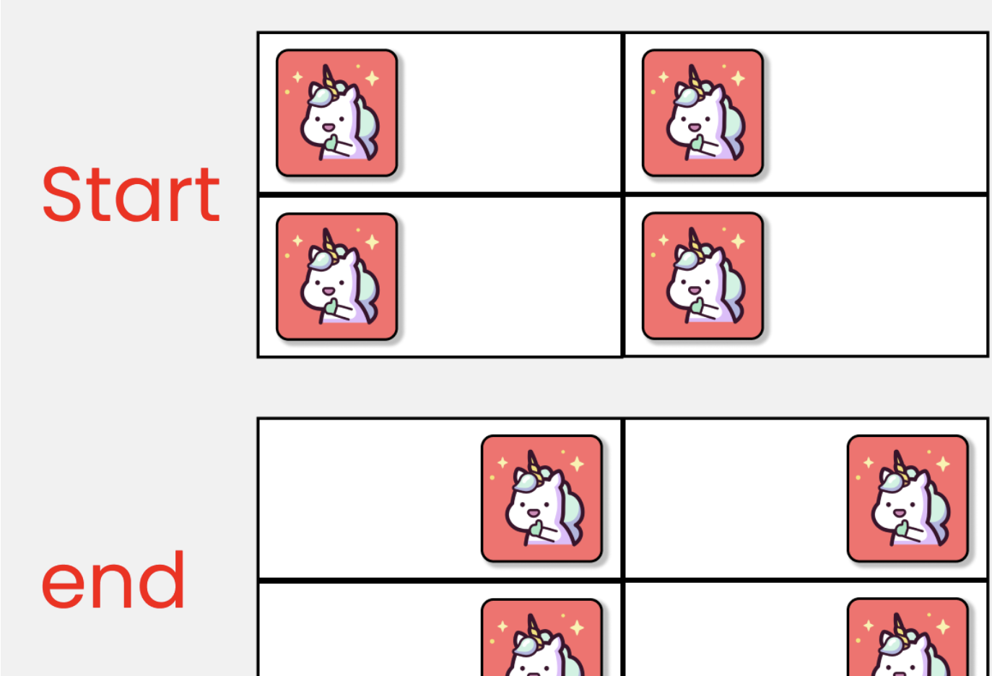
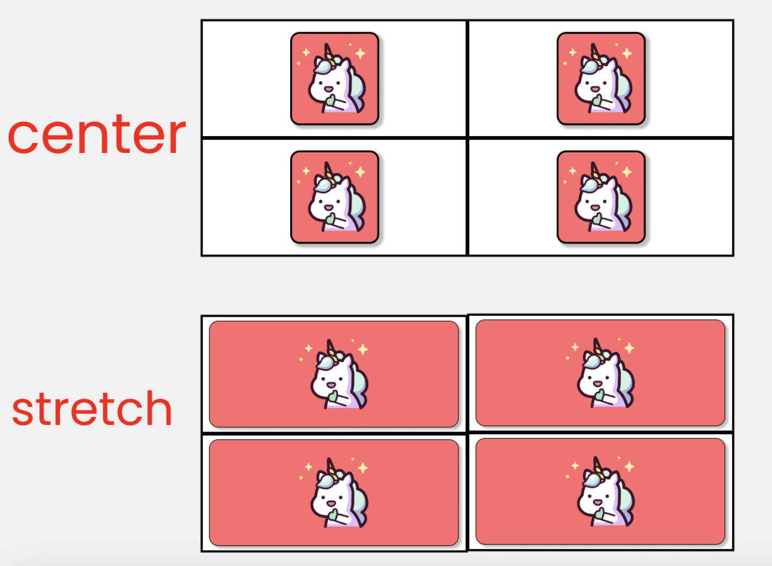
justify-items
Position grid-items (children) inside grid containers along the X-Axis [Main Axis].
start – aligns items to be flush with the start edge of their cell
end – aligns items to be flush with the end edge of their cell
center – aligns items in the center of their cell
stretch – fills the whole width of the cell (this is the default)

Slide 23
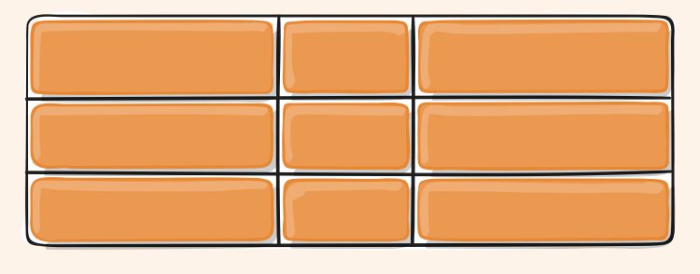
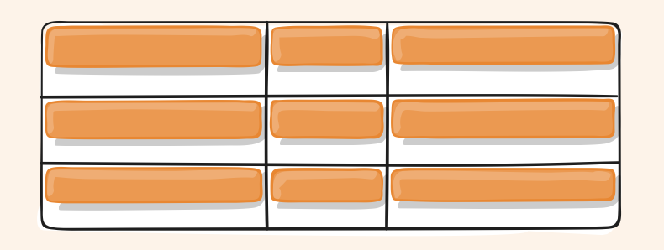
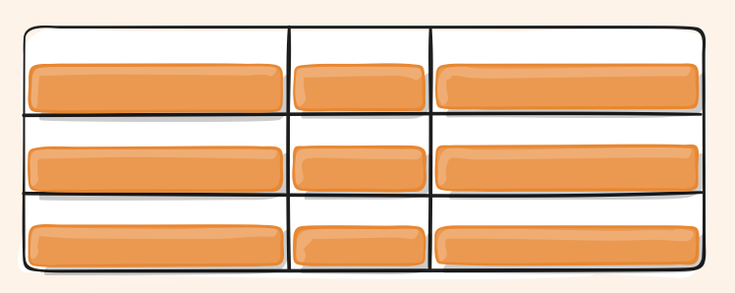
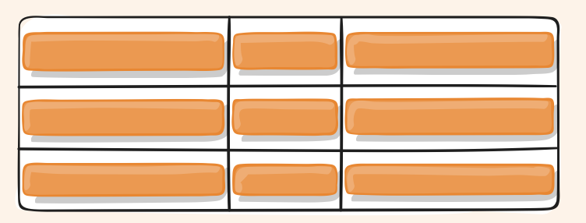
align-items
Stretch
Start
end
center
Position grid-items (children) inside the grid container along the Y-Axis [Cross Axis].
stretch – fills the whole height of the cell (this is the default)
start – aligns items to be flush with the start edge of their cell
end – aligns items to be flush with the end edge of their cell
center – aligns items in the center of their cell

Slide 24
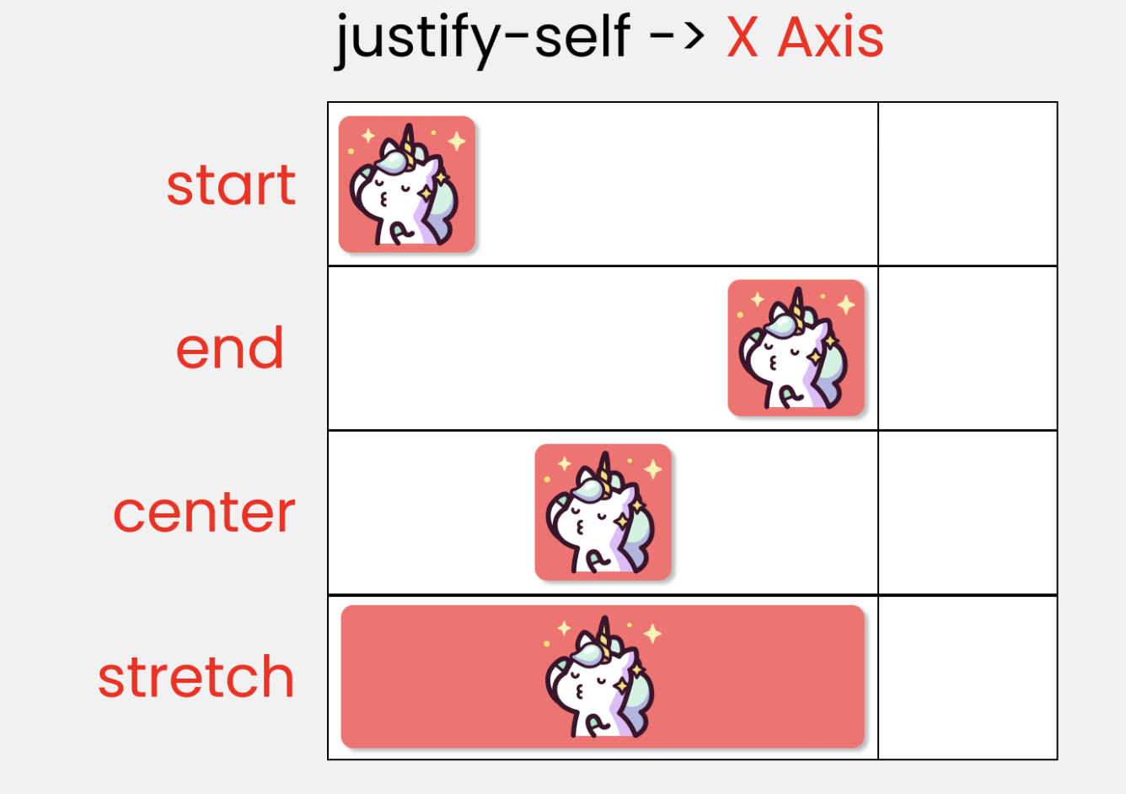
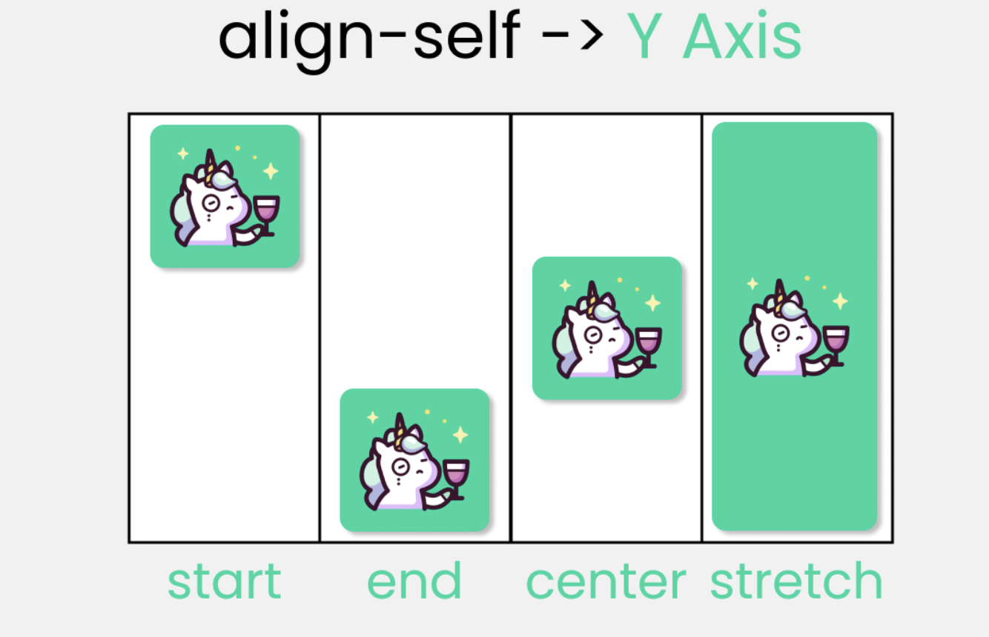
justify-self align-self
this property to position 1 individual grid-item (child) inside a grid container along the X-Axis [Main Axis].
this property to position 1 individual grid-item (child) inside a grid container along the Y-Axis [Cross Axis].

Slide 25
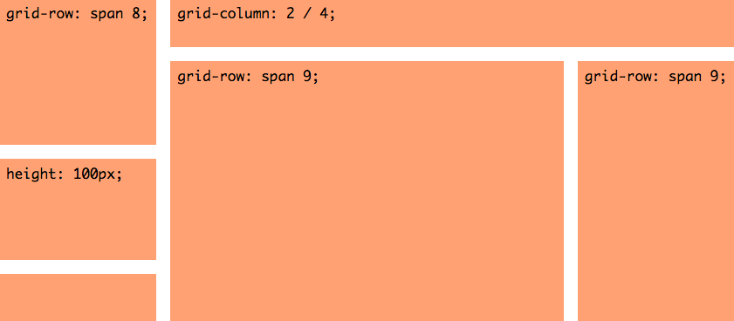
Grid-span
specifying the start and end edge of its grid area.

Slide 26
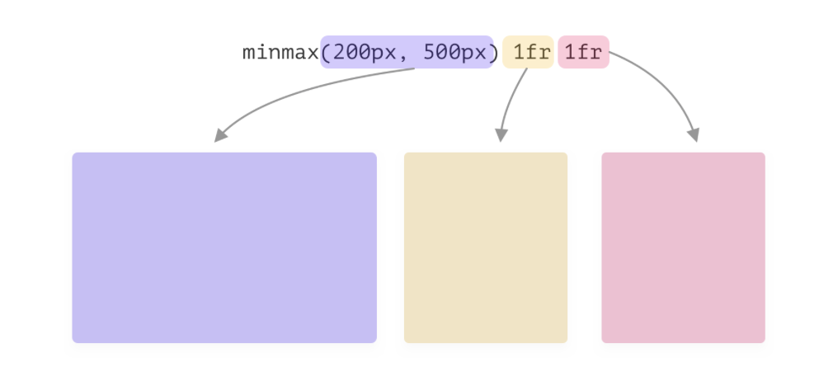
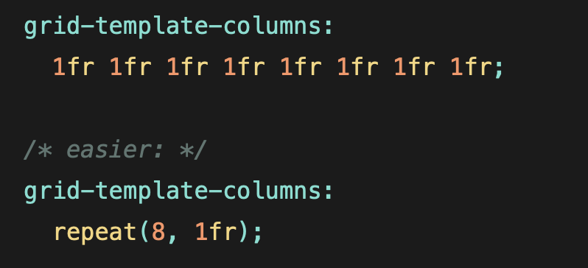
Special Units & Functions
fr units: portion of the remaining space
Sizing Functions:
fit-content(): uses the space available, but never less than min-content and never more than max-content
minmax(min, max): sets a minimum and maximum value for what the length is available to be
repeat(): Saves space

Slide 27
Advantages of Grid
CSS Grid simplifies the creation of complex web layouts.
Eliminates the need for external libraries and layout hacks.
Two-Dimensional Layout
Powerful tools for creating responsive layouts.
Easy reordering and resizing of elements for different screen sizes.
Precise control over horizontal and vertical alignment. Hence easy to align items within the grid.
Supports flexible layout design.
Automatically creates rows and columns as needed.
Automatically places items in the next available space.
Simplifies dynamic content layouts.
Supported by all modern browsers.
Becomes more powerful when used in combination with flex

Slide 28




Slide 29


Slide 30
Bootstrap is a popular open-source CSS framework for developing responsive and mobile-first websites.
History
2011: Bootstrap was released by Twitter.
2013: Bootstrap 3 focused on mobile-first design.
2015: Bootstrap 4 introduced significant changes, including a switch to Flexbox.
2018: Bootstrap 4 became the official version.
2020: Bootstrap 5 was released, removing jQuery dependency and adding new features.

Slide 31




Advantages of Bootstrap
Simplifies the process of creating responsive designs.
Pre-built components and utility classes save development time.
Consistent design across different browsers and devices.
Large community and extensive documentation for support.

Slide 32

Key Features
Responsive Grid System: 12-column grid system for creating flexible layouts.
Pre-designed Components: Buttons, forms, navbars, modals, etc.
Utility Classes: Classes for spacing, typography, colors, and more.
JavaScript Plugins:includes a range of JavaScript plugins for interactive components such as modals, tooltips, carousels, and collapsible elements.
Breakpoints allow for responsive design, adjusting layout for different devices.
Bootstrap can be customized using custom CSS

Slide 33
Getting Started with Bootstrap
Include Bootstrap via CDN or download and host locally.
For more control and to integrate Bootstrap into a build system, use npm.
Basic structure involves linking Bootstrap CSS and JS in your HTML file.

Slide 34
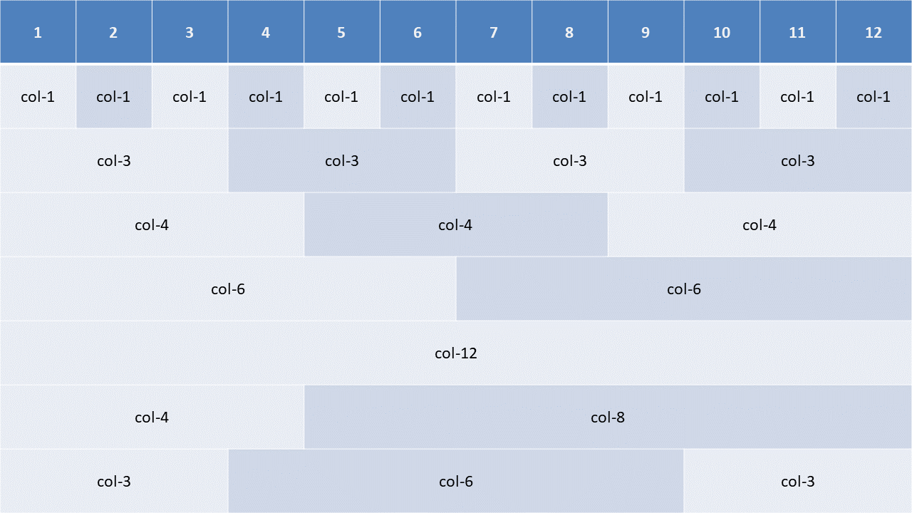
12-column grid system

Slide 35
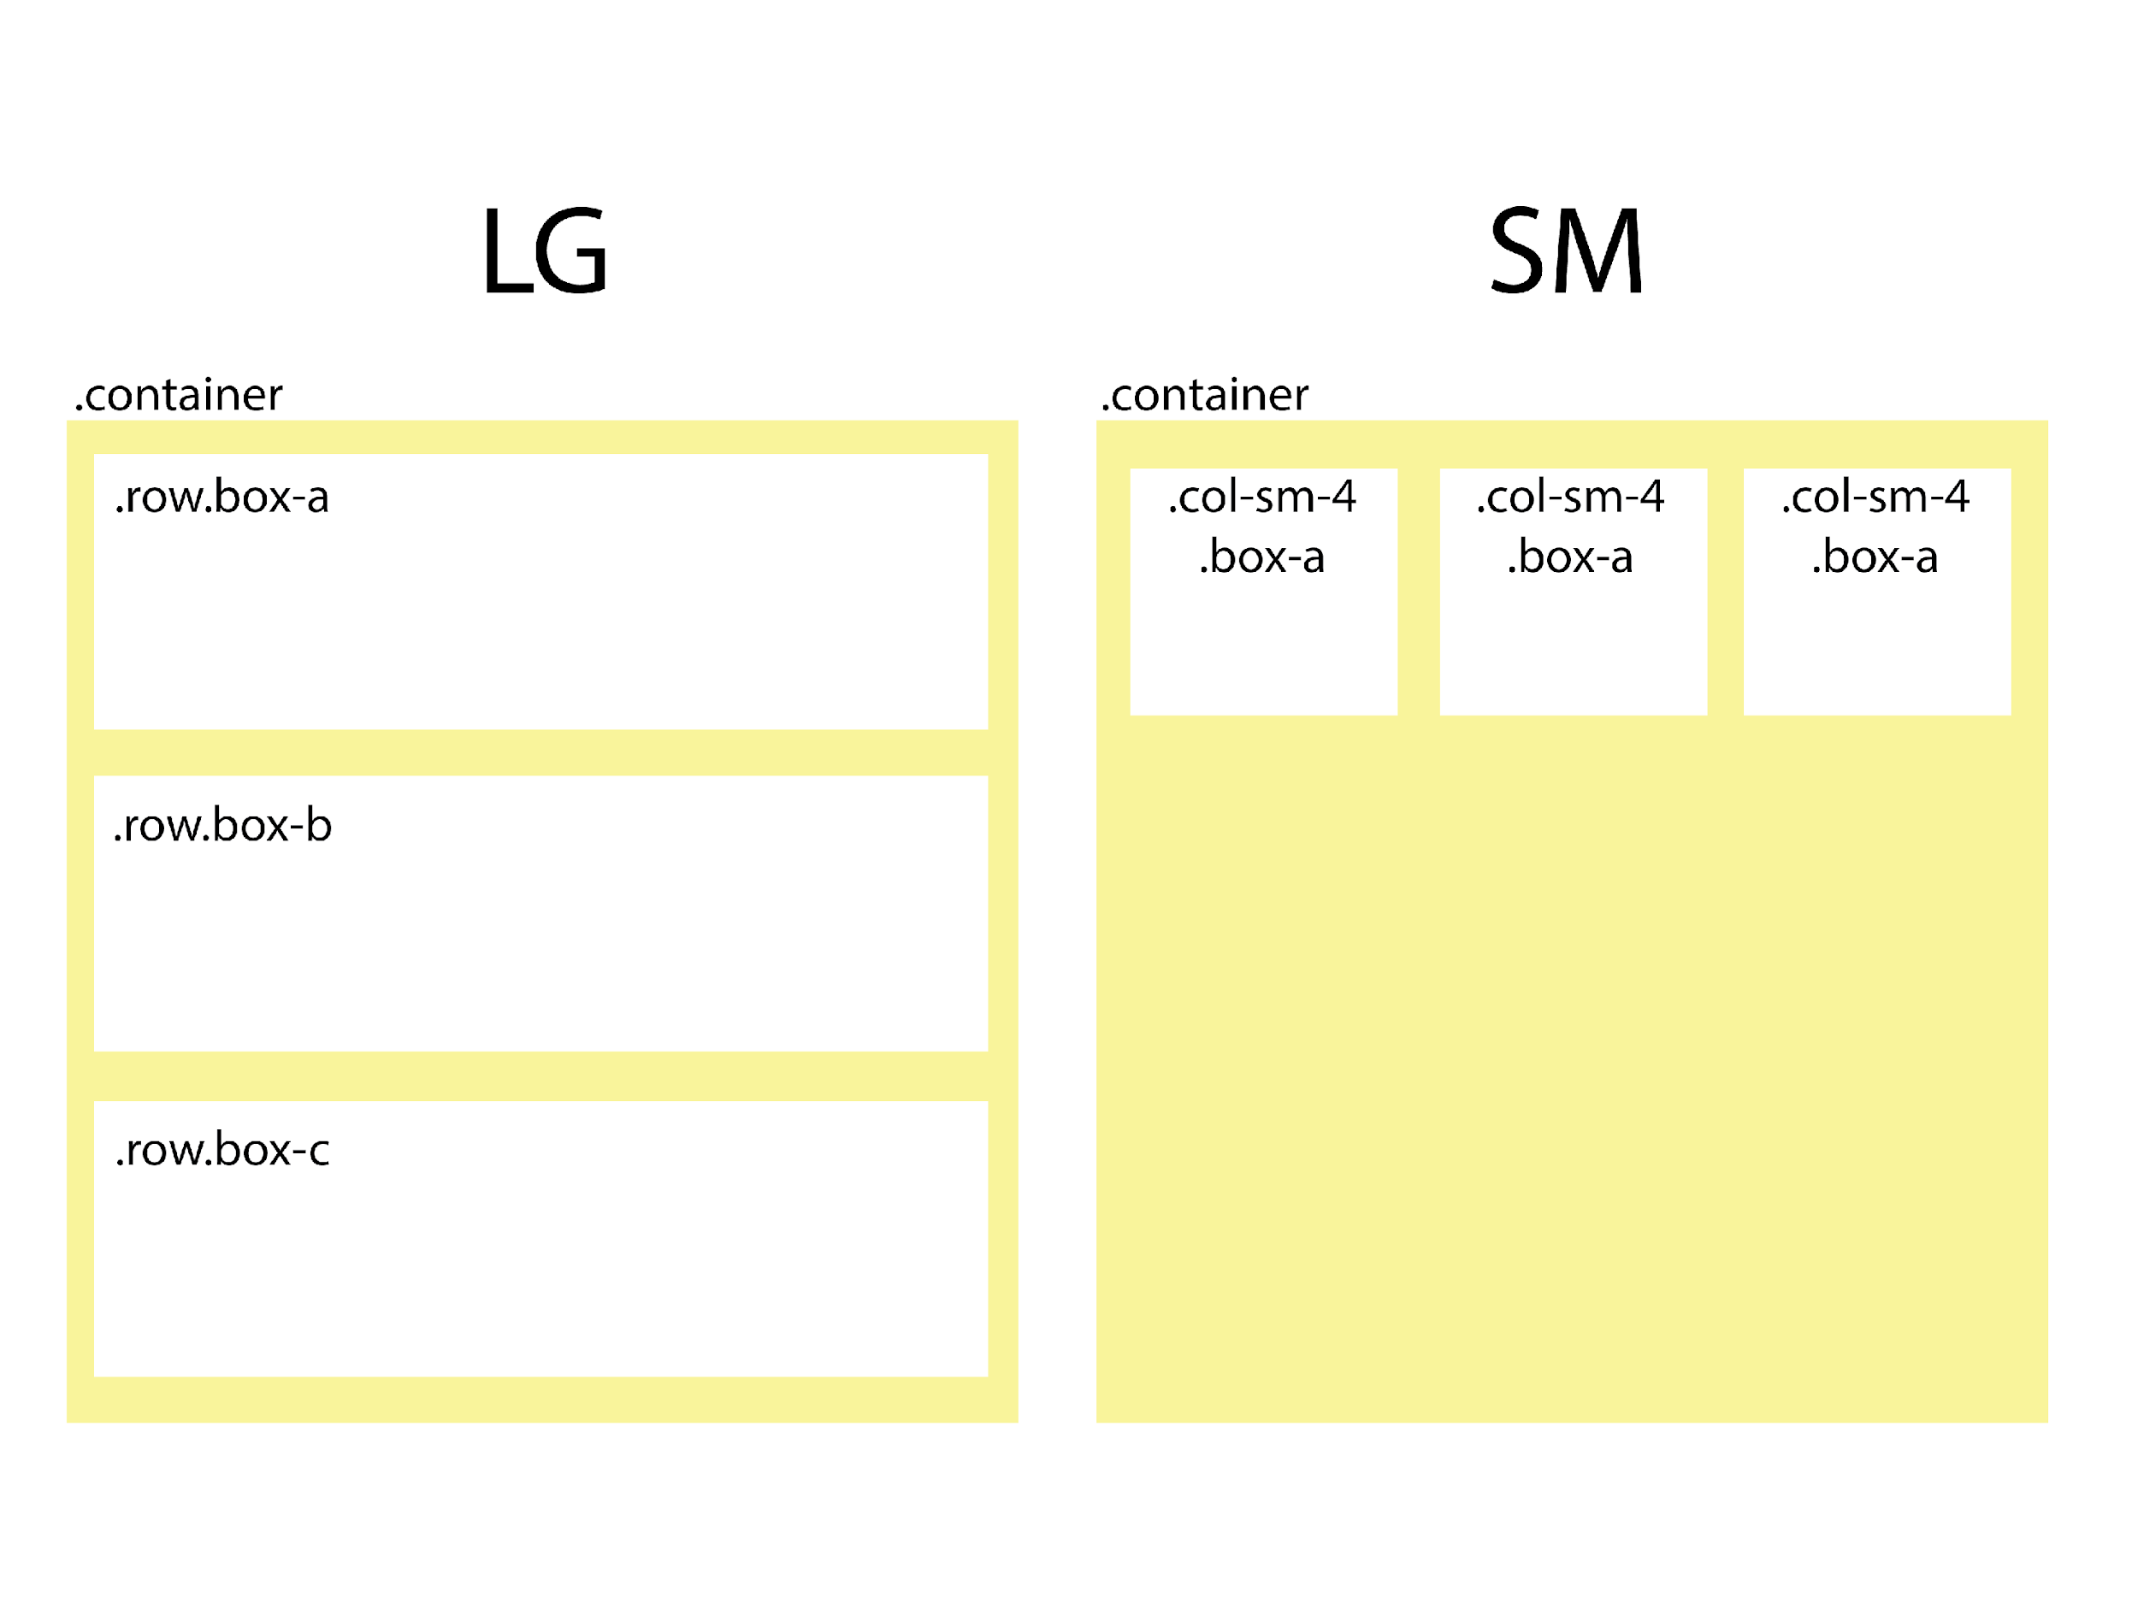
Bootstrap container
Container is used to center and horizontally pad your site's contents.
Bootstrap provides three different types of containers:
.container: This provides a responsive fixed width container. The width of the container will change according to the breakpoint.
.container-fluid: This provides a full-width container, spanning the entire width of the viewport.
.container-{breakpoint}: This provides a container that is 100% wide until the specified breakpoint is reached. For example, .container-sm is 100% wide until the small breakpoint is reached.

Slide 36
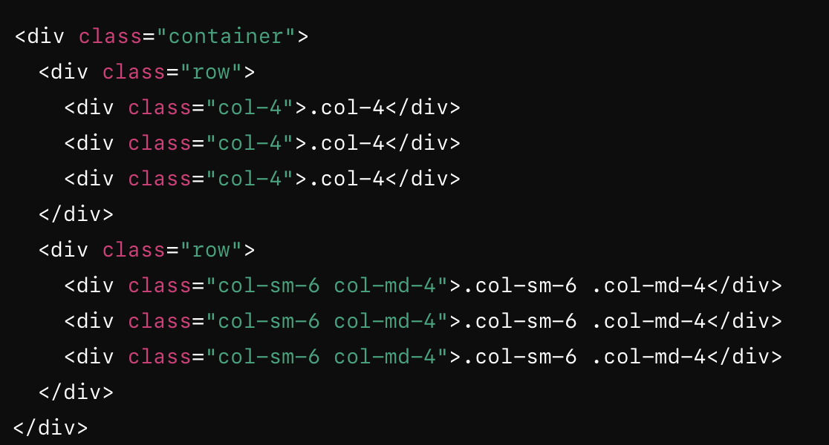
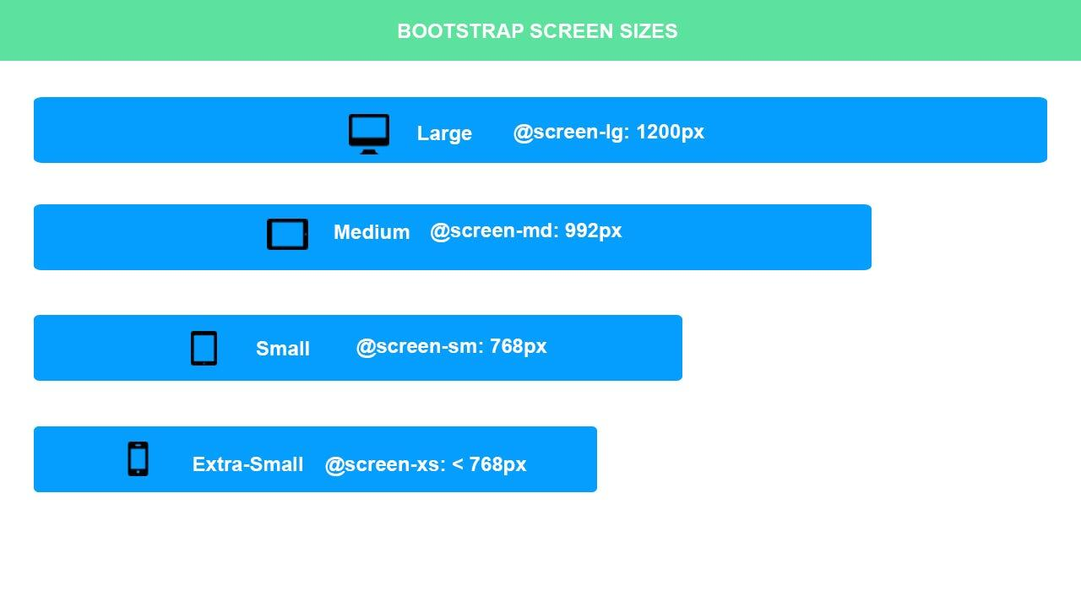
Sized colums
Responsive columns adjust their size based on the screen size.
Auto-layout columns automatically adjust their width to fit the available space.
Columns in Bootstrap are defined using .col- classes.
can specify column sizes for different screen sizes using the following classes:.col- for extra small devices (portrait phones, less than 576px)
.col-sm- for small devices (landscape phones, 576px and up)
.col-md- for medium devices (tablets, 768px and up)
.col-lg- for large devices (desktops, 992px and up)
.col-xl- for extra large devices (large desktops, 1200px and up)
.col classes to create equal-width columns that grow and shrink to fit the available space.

Slide 37
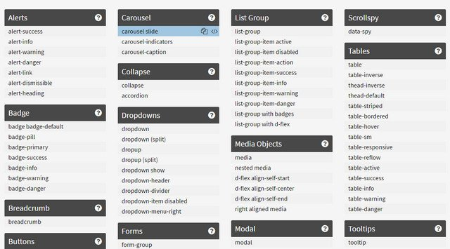
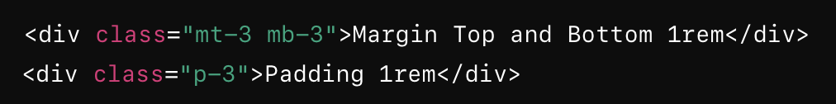
Bootstrap utility classes
Predefined CSS classes that help you quickly apply common CSS styles to elements without writing custom CSS.
Utility functions, such as spacing, text alignment, color, display properties, and more.
Helps to build responsive layouts efficiently by simply adding these classes to HTML elements.

Slide 38
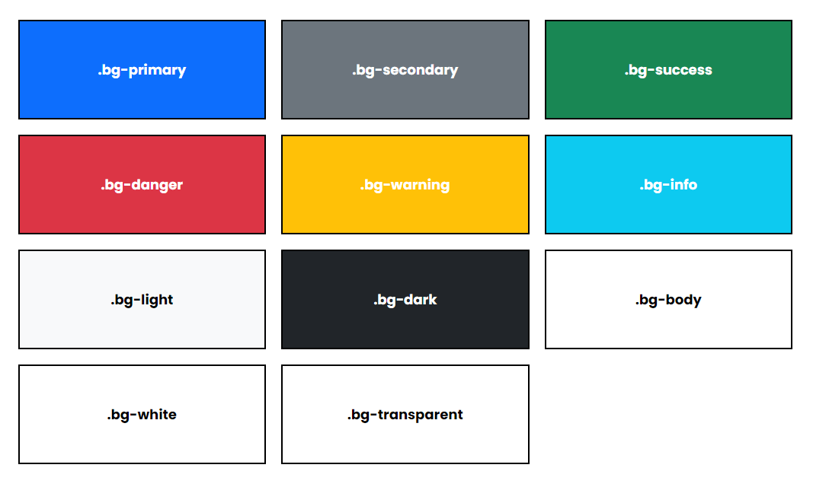
Colors

Slide 39
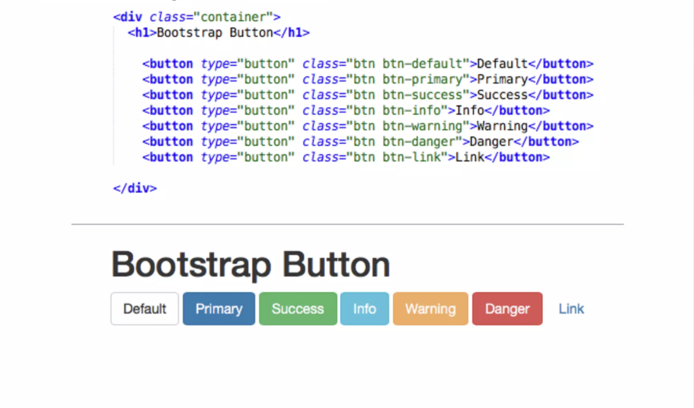

Slide 40
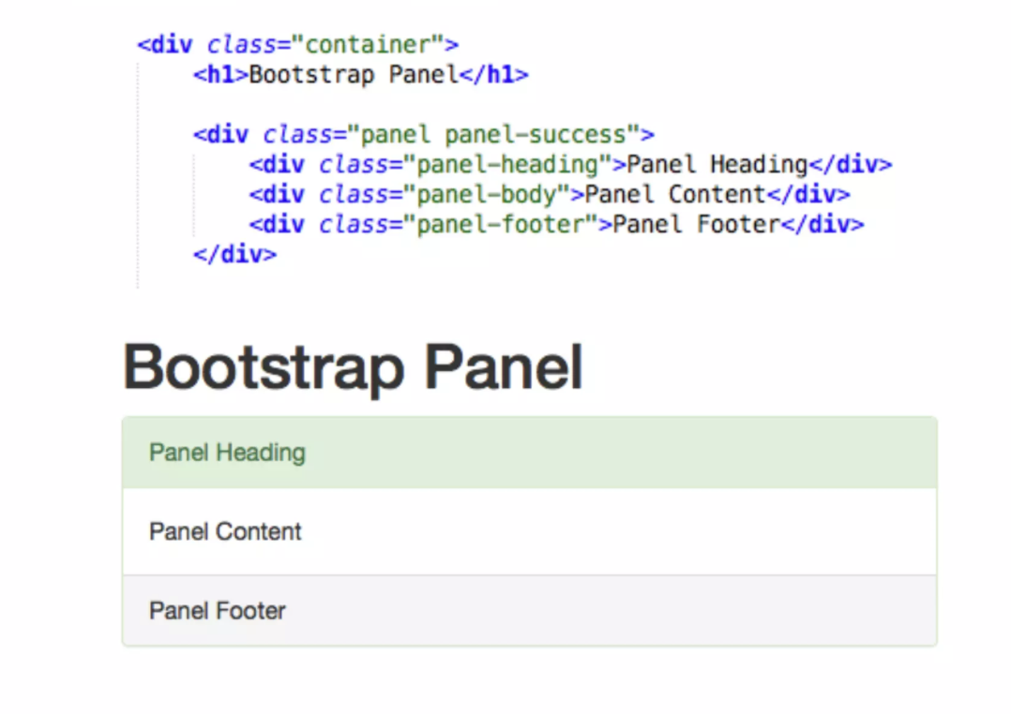

Slide 41
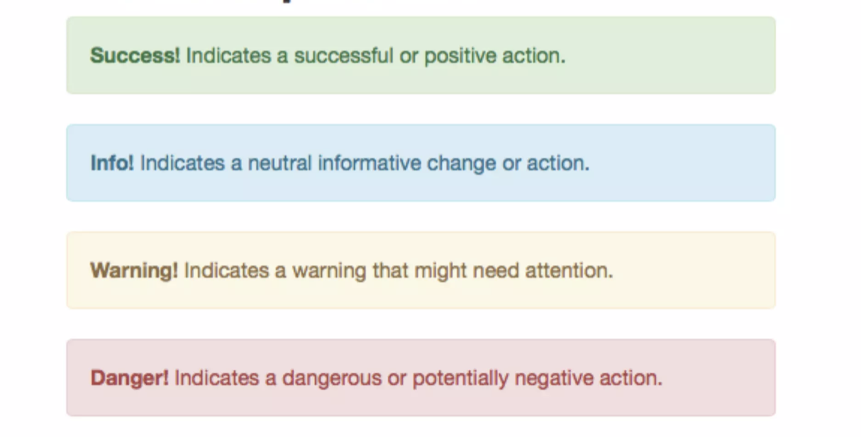
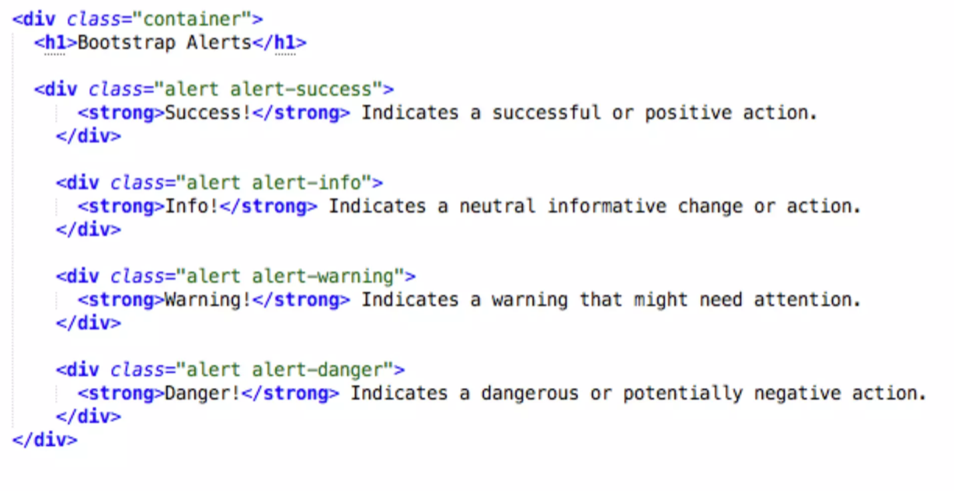
Alert

Slide 42
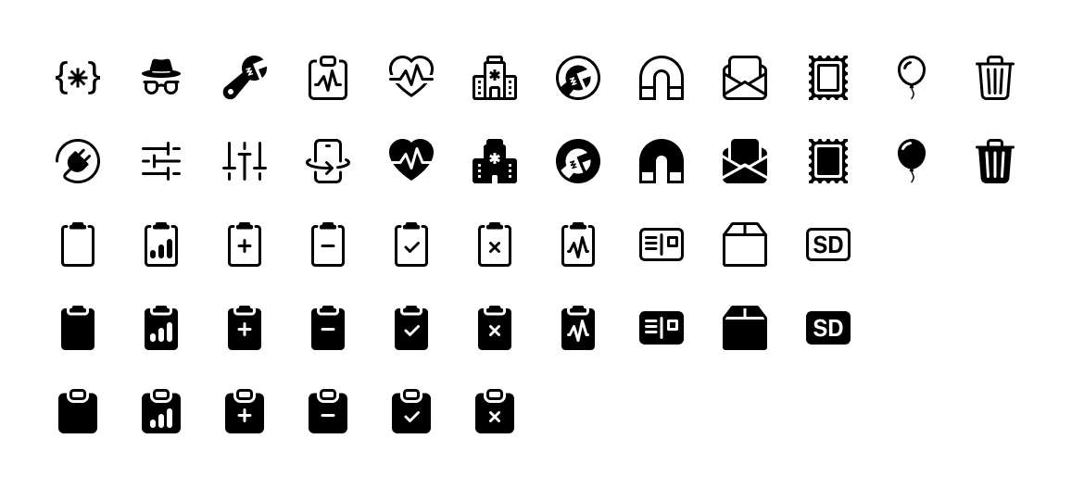
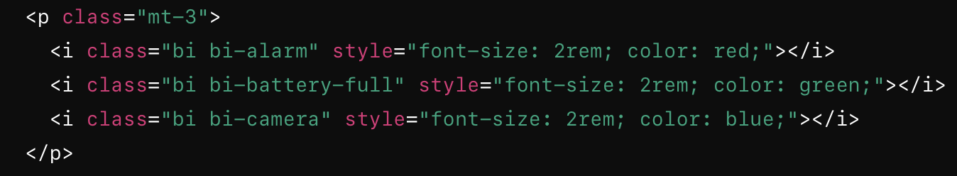
Bootstrap Icons
It offers a wide range of SVG-based icons that you can easily integrate into your projects.

Slide 43

Disadvantages of Bootstrap
Requires a lot of HTML markup and classes, which can lead to cluttered code.
Extensive use of classes can make the html less readable and harder to maintain.
Default styles can make websites look similar, leading to a lack of uniqueness.
Including the entire bootstrap library can add unnecessary bloat to your project.
Unused components and styles can slow down page load times, impacting performance.
Designed to be easy to use, there is still a learning curve.
Some versions of bootstrap rely on jquery for javascript components, adding an extra dependency.
Dependencies can increase the overall size of your project and may conflict with other libraries or frameworks.
Provides a lot of built-in functionality, it can be limiting for highly custom designs.

Slide 44
Refences
https://css-tricks.com/snippets/css/complete-guide-grid/
https://www.w3schools.com/css/css_grid.asp
https://css-tricks.com/snippets/css/a-guide-to-flexbox/
https://www.w3schools.com/css/css_grid.asp

